Slide 1


PAVAN TRAVEL AGENSY
Book Now
91105-64858
It's Time
For Holiday
www.pavantravelagensy.com

Slide 2
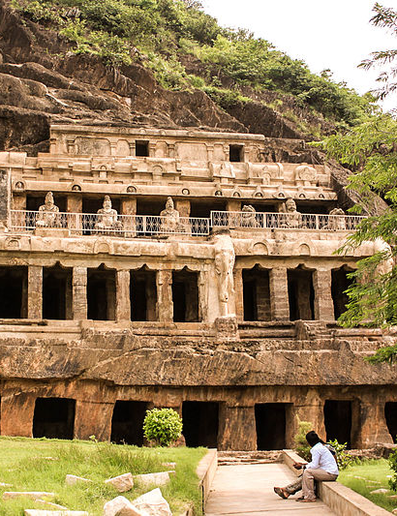
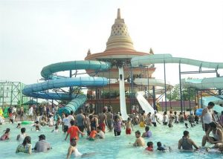
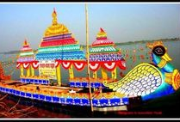
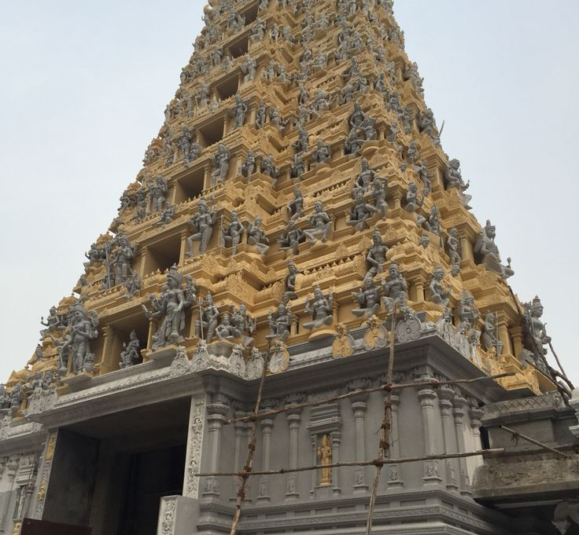
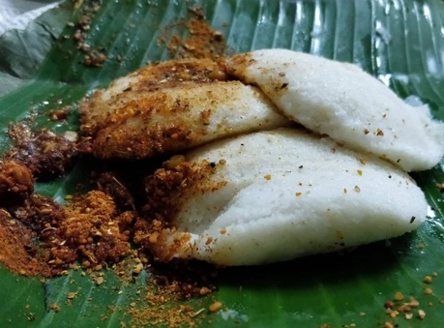
Historic Landmarks: Vijayawada is home to several historic landmarks, including the Kanaka Durga Temple, the Prakasam Barrage, and the Undavalli Caves. These sites offer a glimpse into the city's rich cultural heritaSge.
Festivals: Vijayawada is famous for its vibrant festivals, including the Krishna Pushkaralu, a Hindu festival that takes place once every 12 years, and Dussehra, a 10-day festival that celebrates the victory of good over evil.
Food: Vijayawada is known for its spicy and flavorful Andhra cuisine. Visitors can try a variety of dishes, including biryanis, curries, and seafood.
Nature: Vijayawada is located on the banks of the Krishna River and offers a range of natural attractions, including the Kolleru Bird Sanctuary, which is home to a variety of migratory birds.
Museums: Vijayawada has several museums, including the Victoria Jubilee Museum and the Andhra Pradesh State Museum. These museums showcase the art, history, and culture of Andhra Pradesh.
Parks and Gardens: Vijayawada has several parks and gardens, including the VMC Park, Gandhi Hill, and the Prakasam Park. These parks offer a peaceful retreat from the hustle and bustle of the city.
Shopping: Vijayawada has several shopping centers and markets, including the MG Road, PVP Square Mall, and Besant Road. Visitors can shop for traditional handicrafts, textiles, and souvenirs.
Accommodation: Vijayawada has a range of accommodation options, including luxury hotels, budget-friendly guesthouses, and homestays.

Slide 3
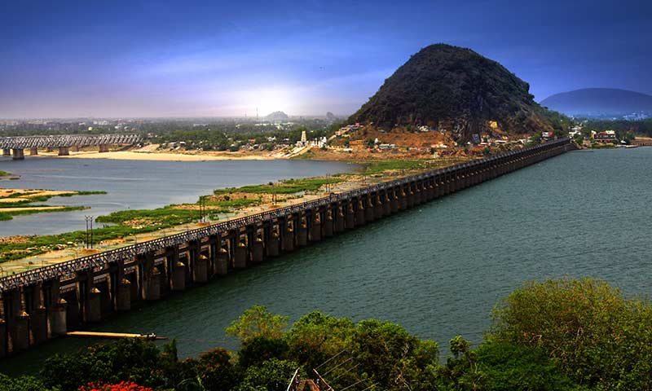
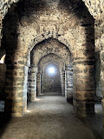
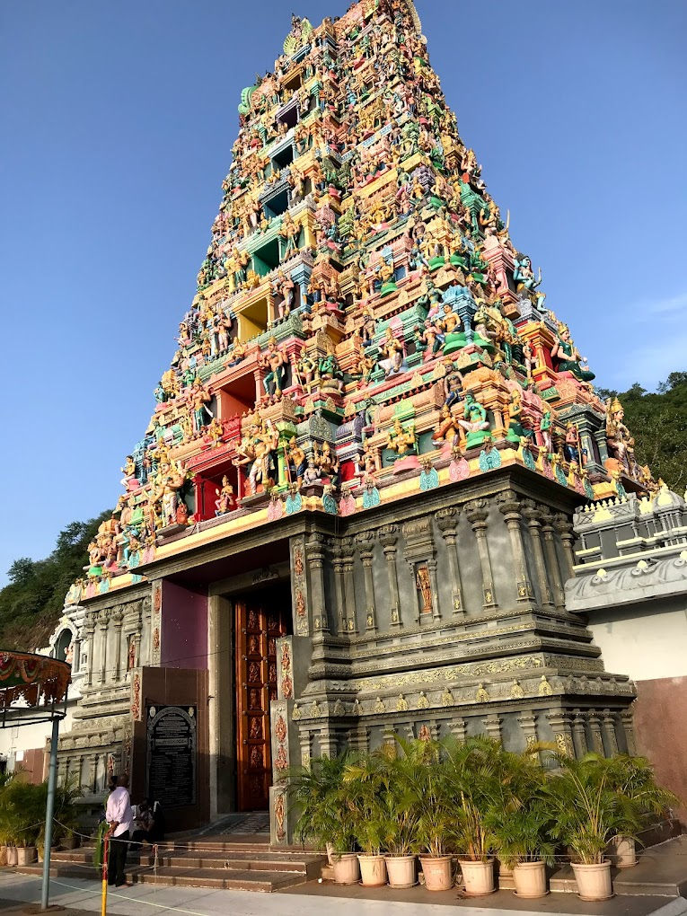
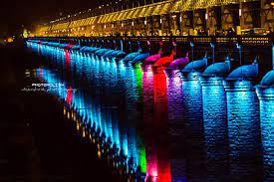
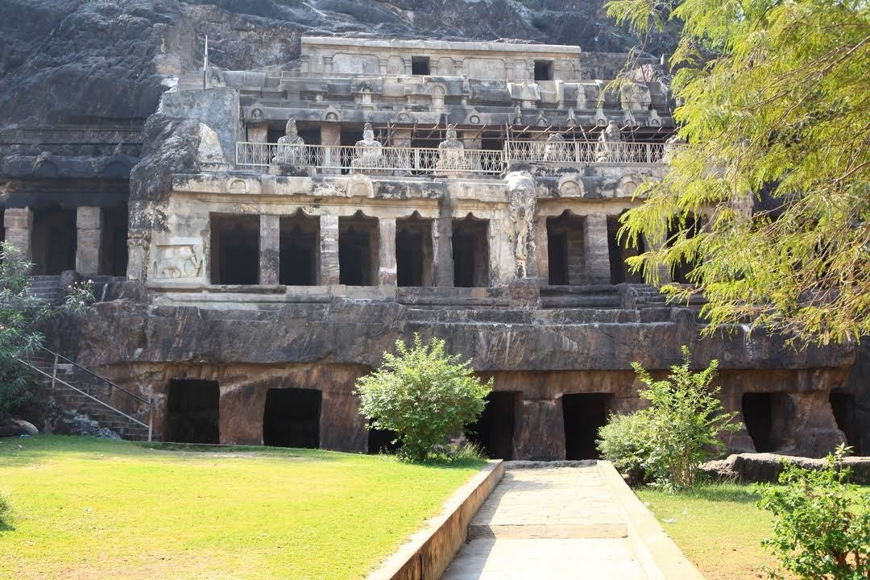
Vijayawada is a city in the state of Andhra Pradesh, India, with a rich history and culture.
Kanaka Durga Temple: A famous Hindu temple dedicated to Goddess Durga, located on a hill overlooking the city.
Prakasam Barrage: A large dam built across the Krishna River, which offers stunning views of the river and the city.
Undavalli Caves: An ancient rock-cut temple dating back to the 7th century, featuring intricate carvings and beautiful sculptures.
Kondapalli Fort: A hilltop fort built in the 14th century, which offers panoramic views of the surrounding countryside.
Bhavani Island: A popular tourist destination located on the Krishna River, featuring a beautiful park, water sports, and a restaurant.
Victoria Jubilee Museum: A museum dedicated to the history and culture of Andhra Pradesh, featuring a wide range of exhibits and artifacts.
Gandhi Hill: A hilltop park dedicated to Mahatma Gandhi, which offers stunning views of the city and houses a memorial to the great leader.
Prakasam Park: A beautiful park located on the banks of the Krishna River, featuring walking paths, a musical fountain, and a children's play area.

